Slide 1
From Challenges to Solutions:
Strengthening the Acceptability and Implementation
Of SDR-PEP in Sindh, Pakistan
Single-Dose Rifampicin (SDR) for Leprosy Prevention
Workshop on Understand barriers • Improve counselling • Protect confidentiality
Abdul Salam

Slide 2
Data: July 2025- June 2026
 | I. Cases | Screened | House Hold |  |  |  | Neighbor / Social |  |  |  | Prev SDR
 |  |  | Screened | Refusal | SDR | Lep Suspect | Screened | Refusal | SDR | Lep Suspect
2025 | 158 | 6903 | 2644 | 18 | 2403 | 20 | 4259 | 43 | 3787 | 16 | 17
2026 | 158 | 5826 | 2728 | 07 | 2418 | 21 | 3098 | 14 | 2882 | 14 | 165
Total | 316 | 12729 | 5372 | 25 | 4821 | 41 | 7357 | 57 | 6669 | 30 | 182
 |  |  | 42% | 0.46% | 89% | 0.76% | 57% | 0.77% | 90% | 0.40% | 1.4%
 |  | Screened | Refusal | Lep Suspect | SDR | Prev SDR
 |  | 12729 | 74 | 71 | 11490 | 182
 |  |  | 0.58% | 0.55% | 90% | 1.4%

Slide 3
Karachi Data: July 2025- June 2026
 | I. Cases | Screened | House Hold |  |  |  | Neighbor / Social |  |  |  | Prev SDR
 |  |  | Screened | Refusal | SDR | Lep Suspect | Screened | Refusal | SDR | Lep Suspect
2025 | 751 | 12936 | 7388 | 2590 | 2953 | 12 | 5548 | 1788 | 2816 | 05 | 1230
2026 | 658 | 16106 | 5986 | 1120 | 2729 | 14 | 10120 | 2205 | 4553 | 07 | 1763
Total | 1409 | 29042 | 13374 | 3710 | 5682 | 26 | 15668 | 3993 | 7369 | 12 | 2993
 |  |  | 46% | 27% | 42% | 0.19% | 54% | 25% | 47% | 0.07% | 10%
 |  | Screened | Refusal | Lep Suspect | SDR | Prev SDR
 |  | 29042 | 7703 | 38 | 13051 | 2993
 |  |  | 26% | 0.13% | 45% | 10%

Slide 4
Karachi V Intr-Sindh

Slide 6
1. What makes SDR difficult to accept?
Awareness & understanding
“I feel healthy—why do I need medicine?”
Fear of side effects
Worry about safety, allergies or other medicines
Stigma & confidentiality
Concern that the index patient's diagnosis may be revealed
Social-contact refusal
Neighbours, friends or colleagues may hesitate
Availability & access
Work, school, travel, migration or missed visits
Trust & counselling
Limited time, unclear messages or misconceptions
Also consider family decision-making, language barriers and incomplete documentation.

Slide 7
2. Practical actions for MALC teams
Counsel clearly
Protect privacy
Respect choice
Explain prevention, benefits, possible side effects and when to seek help.
Never disclose the index patient's diagnosis without authorization.
Obtain informed consent; do not pressure contacts who decline.
Plan follow-up
Screen safely
Record accurately
Arrange a suitable revisit for unavailable contacts; avoid repeated low-priority revisits.
Trained staff assess eligibility and follow current national/WHO guidance.
Document counselling, eligibility, consent/refusal, administration and outcome.
SDR is prevention for eligible contacts—not treatment for a person who already has leprosy.

Slide 8
3. SDR implementation pathway
Identify and counsel close contacts
Assess eligibility and safety
Eligible and consents?
YES
Administer SDR per guidance
NO / NOT ELIGIBLE
Respect decision; do not administer
UNAVAILABLE
Record and arrange follow-up
Document outcome: eligibility • consent/refusal • SDR given • follow-up required
Review acceptance, coverage and reasons for refusal

Slide 9
4. What should centers monitor?
Coverage
Contacts screened ÷ contacts identified
SDR acceptance
Eligible contacts accepting SDR ÷ eligible contacts offered SDR
Refusal
Record refusal accurately; reason only if voluntarily shared
Follow-up
Unavailable, untraceable or migrated contacts tracked separately
Safety & quality
Eligibility assessment and administration documented
Equity
Compare household and social contacts without compromising privacy
Use data to improve counselling and access—not to blame contacts or staff.

Slide 10
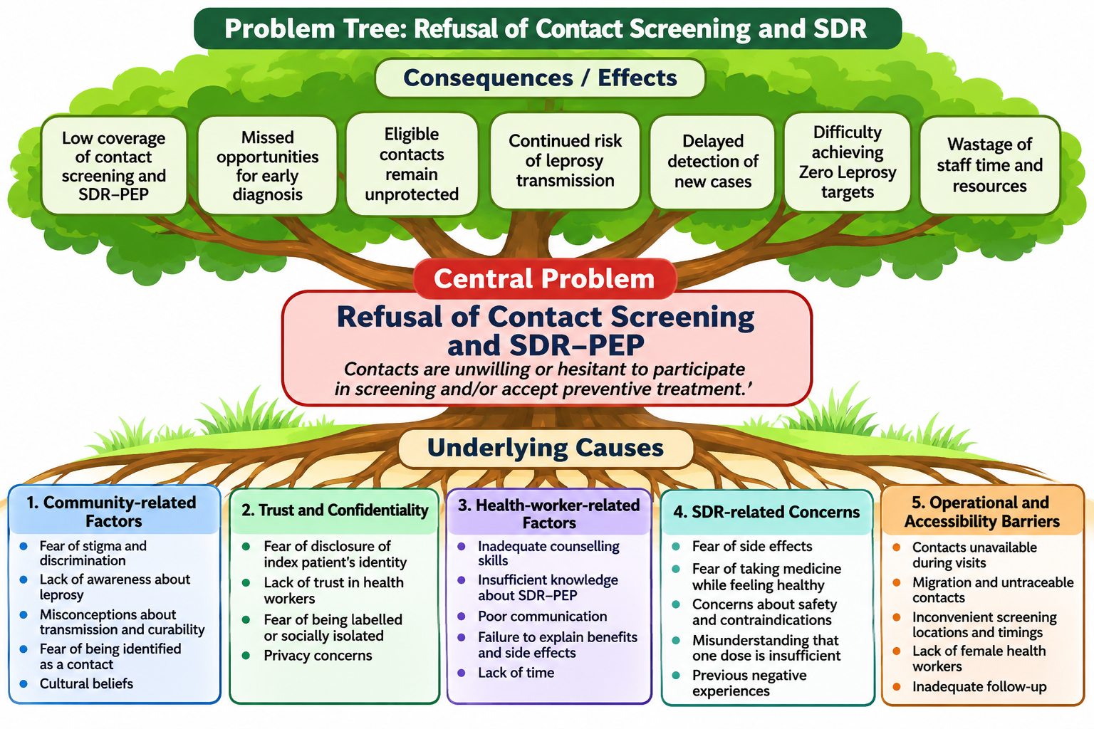

Slide 11
5. Workshop action plan
Challenge identified
Agreed action
Responsible person/team
Timeline
Workshop objective: agree on practical, stigma-sensitive steps to improve informed SDR acceptance and safe delivery.

